Slide 1
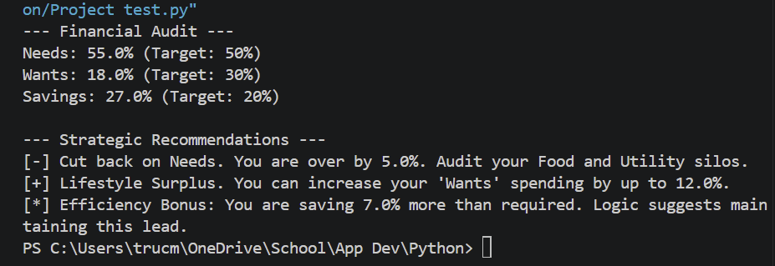
Expenditure Advisor
Created By:
Tru Christian Martin
This program analyzes your spending data to see how well it follows the 50/30/20 budget rule and provides specific advice on how to balance your finances.

